Slide 1



Assessment, Accreditation,
and Syllabi
presented by: Melanie Wicinski, PhD
New Faculty Orientation, August 16, 2023
AState.edu
/ArkansasState
@ArkansasState

Slide 2
Office of Accreditation
and Assessment
Location:
Dean B. Ellis Library, 6th Floor
Extension: 2989
Testing Center
Student Union, 3rd Floor
Extension: 2038
AState.edu
/ArkansasState
@ArkansasState

Slide 3
Assessment
General Education Assessment
If you are teaching a course, you may be required to report data to General Education Committee
Program Assessment
Please get with your Department Chair to determine if you will play a role in your program assessment. If so, our office will be happy to meet with you anytime
AState.edu
/ArkansasState
@ArkansasState

Slide 4
Accreditation and
Program Review
Higher Learning Commission
Accredit 2024
Specialized Accreditation
Please get with your Department Chair to determine if you have a specialized accreditation and what your role will be. Our office is always available to assist.
Program Review
If you don’t have a specialized accreditor, each program must do a program review every 10 years.
AState.edu
/ArkansasState
@ArkansasState

Slide 5
Testing Center
Scantron Services
  We provide forms
  Scan, if requested
  Can break questions into concepts and provide some statistics
Tests Offered
  Placement Tests
  GRE
  Licensure Exams (NYIT)
  Please see the website for more information
AState.edu
/ArkansasState
@ArkansasState

Slide 6
Syllabi
Syllabi Resources
  Located on our website in gray box on the right of screen: https://www.astate.edu/a/assessment/syllabi
  Sample syllabi
  Repository instructions
  Every other year, syllabi are reviewed to ensure they meet basic requirements:
    Course Description
    Student Learning Outcomes
    Follow Course Map provided to our office
Syllabus Due Dates: https://www.astate.edu/a/assessment/index.dot
  Full Fall Semester and First 8 Week Term– September 8
  Second 8 Week Term - October 27
Link to upload your syllabi every semester is on my.AState
AState.edu
/ArkansasState
@ArkansasState

Slide 7
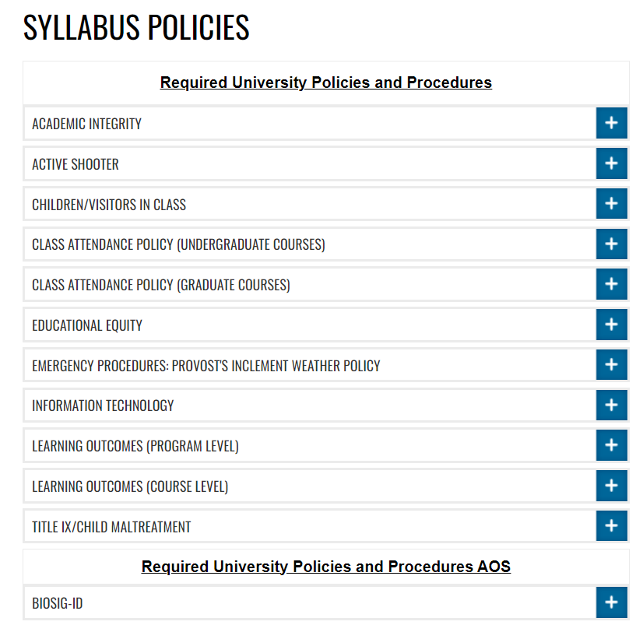
Syllabi Continued
Policy and Procedure Statements:
e.g., Interruption of Instruction, Title IX and Educational Equity Statements, etc.
https://www.astate.edu/a/assessment/syllabi-policies
AState.edu
/ArkansasState
@ArkansasState

